Slide 1
Connected Kingston Collections
We’ve been working over the last 6 months with local partners to curate a series of new ‘collections’ on Connected Kingston. Collections are hand picked services and opportunities that we can pull together under a custom heading.
Active for All (inclusive sports)
Carers Support
Dementia Friendly
Cost of Living
Getting by Online
Support After a Death
In partnership with Inspire Sport
In partnership with Kingston Carers Network
In partnership with Alzheimer’s Society
In partnership with CoL Working Group
In partnership with Super Highways
In partnership with Kingston
Bereavement Service
These collections and others like them also feed into the Adult Social Care care assessment referral forms, ensuring residents who need support but who may not be eligible for social care have easy, timely access to the community offer

Slide 2
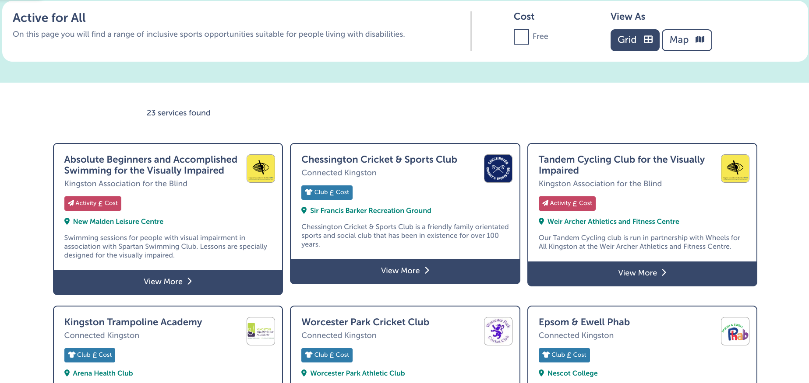
Active for all

Slide 3
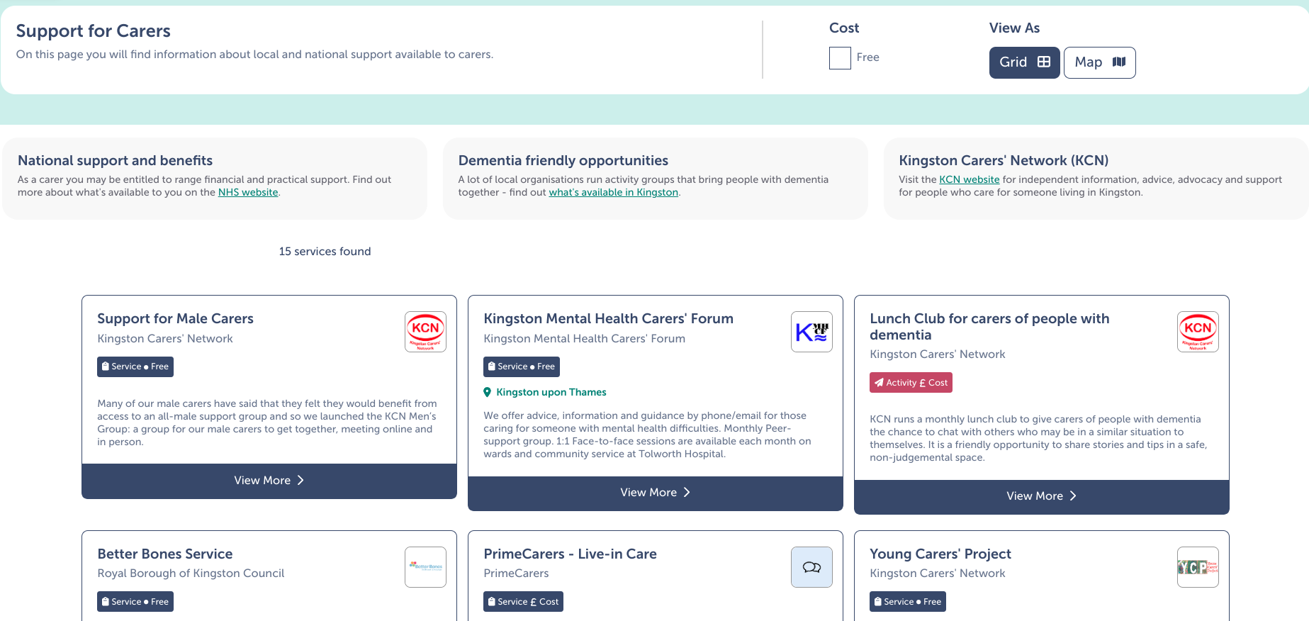
Support for Carers

Slide 4
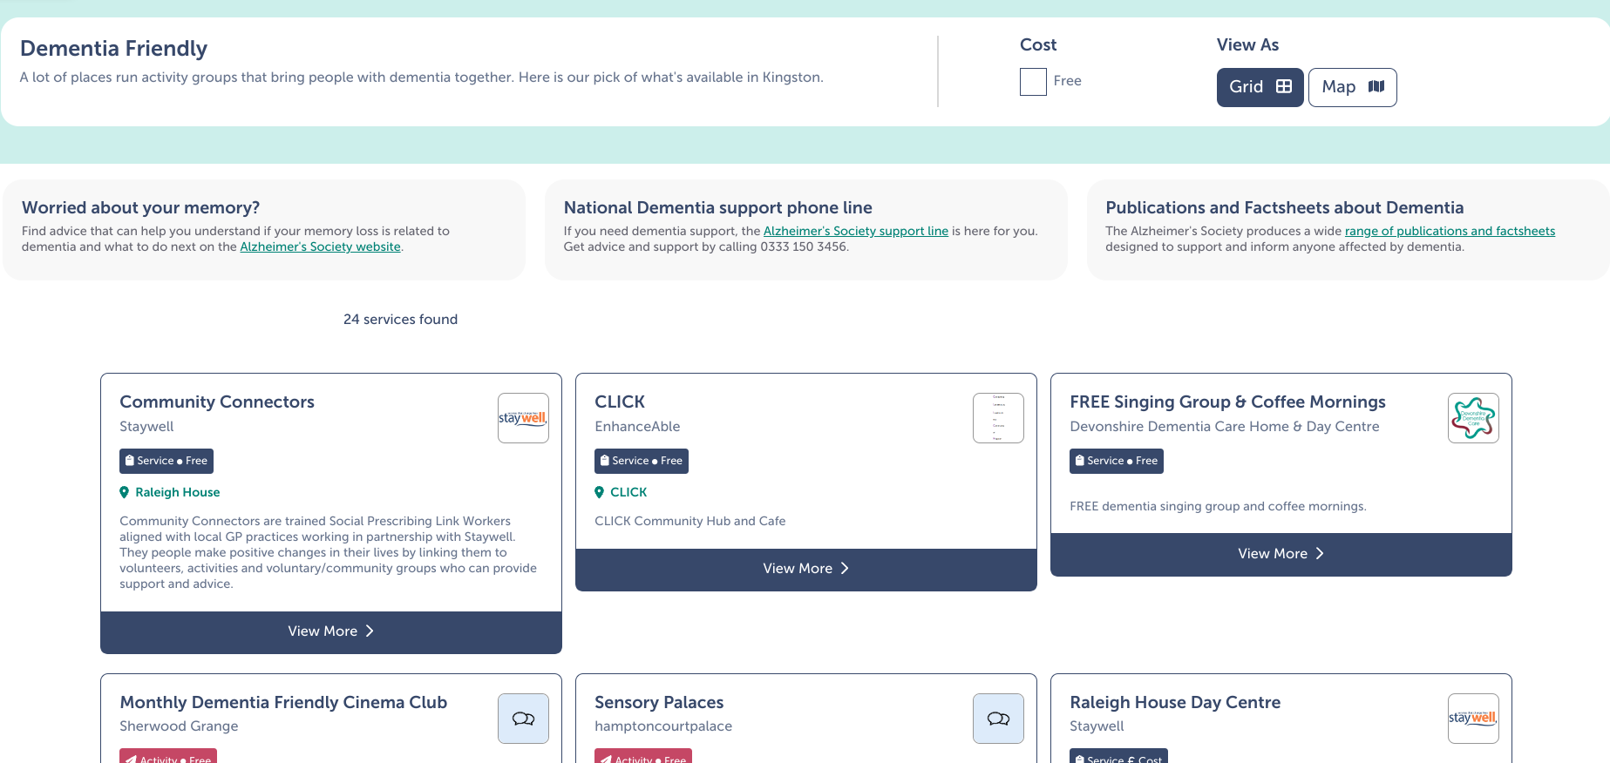
Dementia Friendly

Slide 5
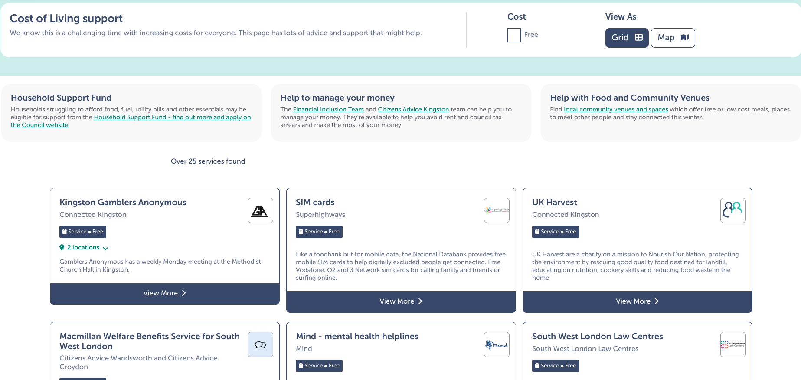
Cost of Living and Help with Food and Community Venues

Slide 6
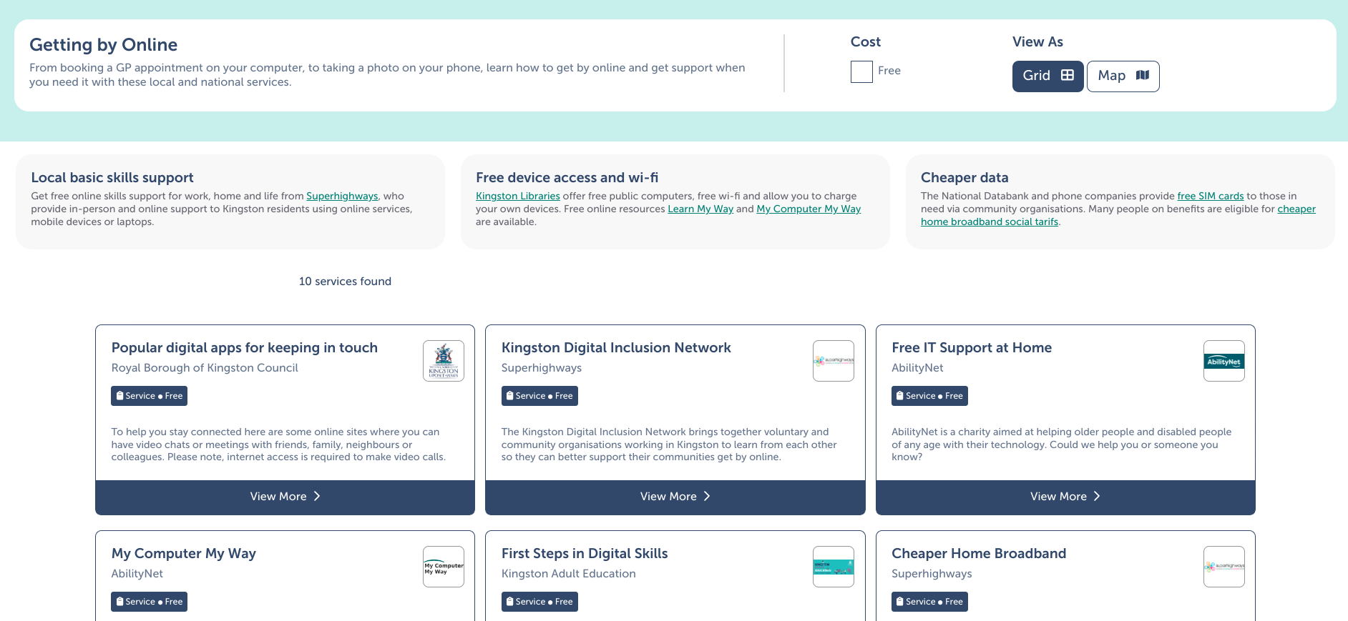
Getting by Online

Slide 7
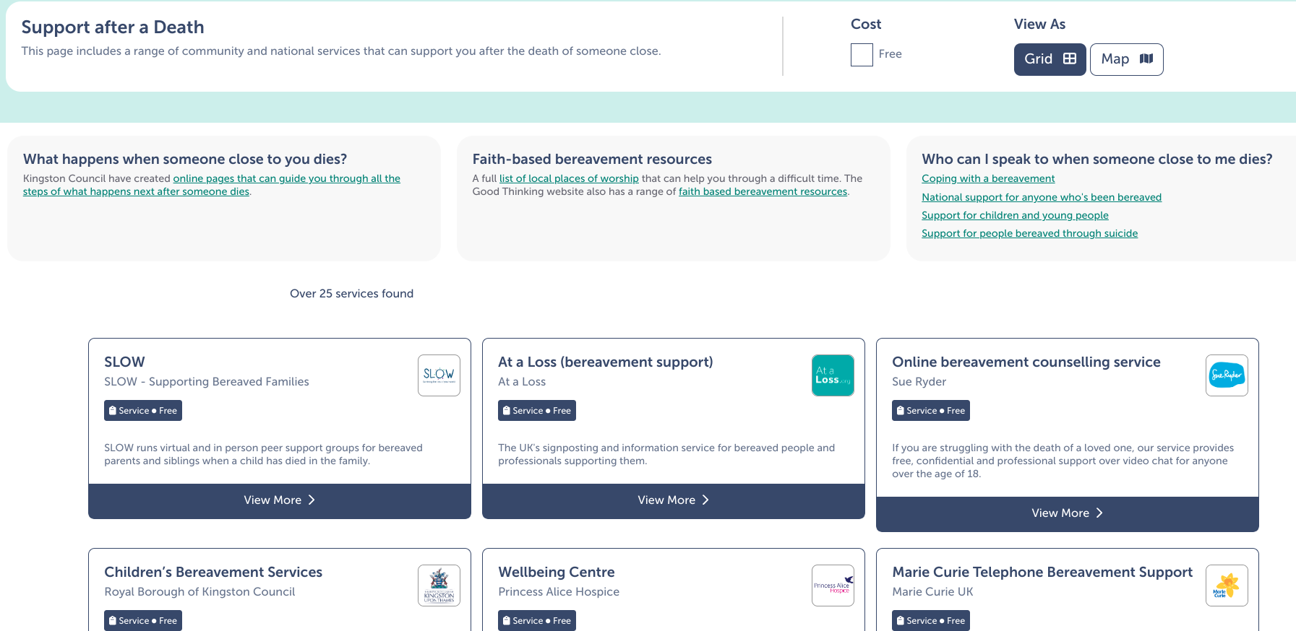
Support after a Death

Slide 8
How Connected Kingston is changing!
Collections is just one of the ways that Connected Kingston has changed since its launch in 2018, and over the next few months we’ll be working with our developer, Ayup, to deliver further upgrades to the site to improve the way people in Kingston engage with what’s happening locally!
Community Events
Information Pages
Advanced Filtering

